Slide 1
College chat bot Using watsonx
PROJECT
Presented By:
Name - DEBESH KUMAR PATEL
G-Mail ID – patel.debeshkumar@gmail.com
College Name- Sambalpur University Institute Of Information Technology, Burla
Course – B.Tech 2nd Year
Department – Computer Science Engineering

Slide 2
OUTLINE
Problem Statement
Proposed System/Solution
System Development Approach (Technology Used)
Result
Conclusion
Future Scope
References

Slide 3
Problem Statement
Create a college admission chatbot helping students with course details, requirements, and application updates. It collects student info like name, phone number, exam rank and interested courses. The bot ensures a smooth experience, guiding students through admission with timely assistance.

Slide 4
Proposed Solution
User Interaction: The chatbot engages users in natural language conversations, using prompts and responses to guide them through the admission process.
Information Collection: It prompts users to input their name, mobile number, JEE Mains rank and interested courses, storing this information securely.
Query Handling: The chatbot responds to inquiries about course details, admission requirements, application status, and general college information with accurate and helpful responses.
User Guidance: It provides step-by-step guidance, directing users on how to proceed with their application, including deadlines and necessary documentation.
Feedback Mechanism: The chatbot incorporates a feedback mechanism to improve its responses and user experience over time, ensuring continuous optimization.

Slide 5
System Approach
The "System Approach" section outlines the overall strategy and methodology for developing and implementing the rental bike prediction system. Here's a suggested structure for this section:
System requirements : windows 11 operating system , 8GB RAM, I3 Processor
Library required to build the model : IBM Watsonx assistant
Internet Connection

Slide 6
Result
a college admission chatbot designed to streamline the application process for prospective students. Users interact naturally with the bot, receiving guidance on admission procedures, course details, and general college information. The bot securely collects necessary information such as name, mobile number, exam rank, and interested courses. It handles user queries efficiently, providing accurate responses and step-by-step guidance. Additionally, a feedback mechanism ensures ongoing improvement of the chatbot's performance and user experience.

Slide 7
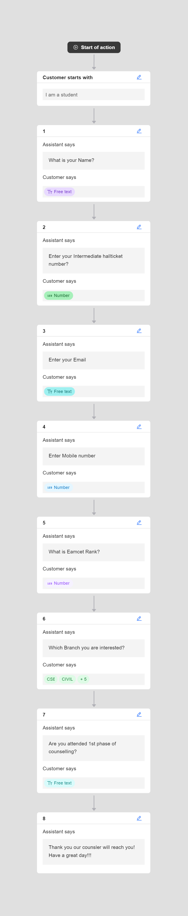
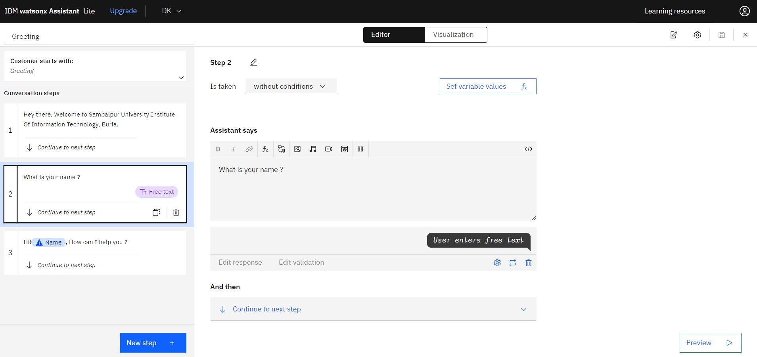
Result

Slide 8
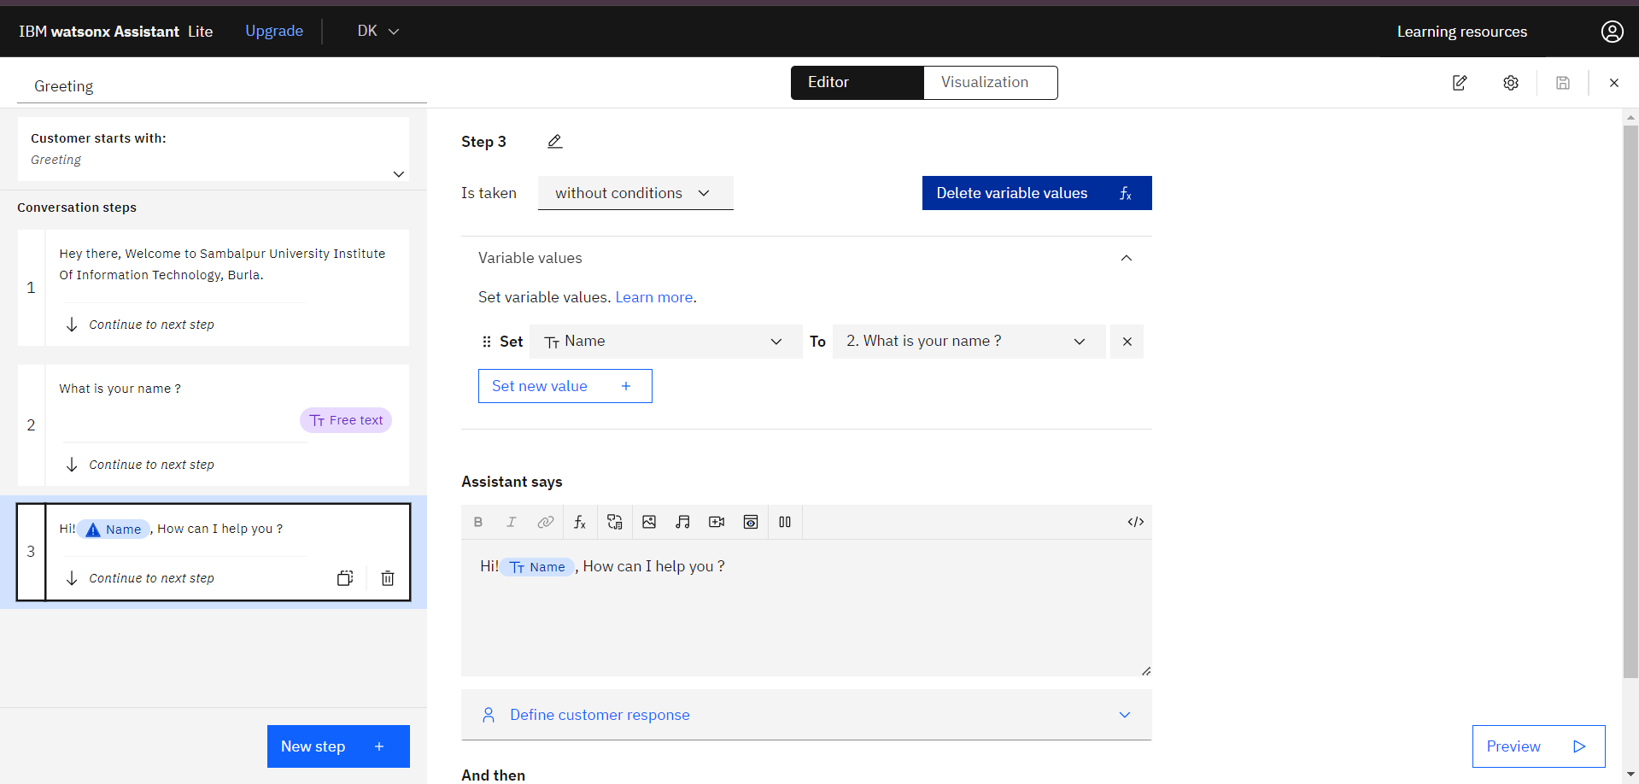
Result

Slide 9
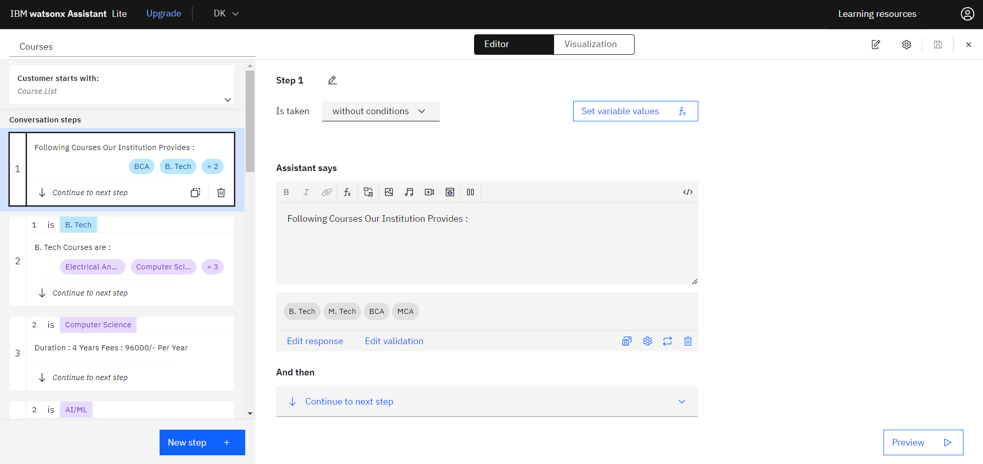
Result

Slide 10
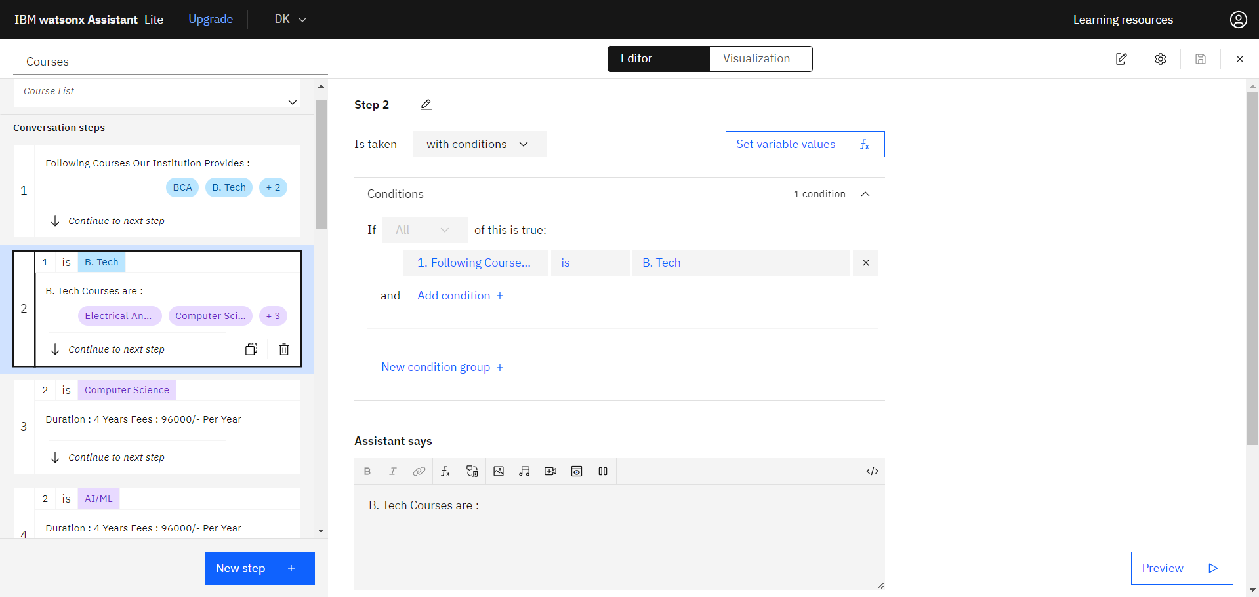
Result

Slide 11
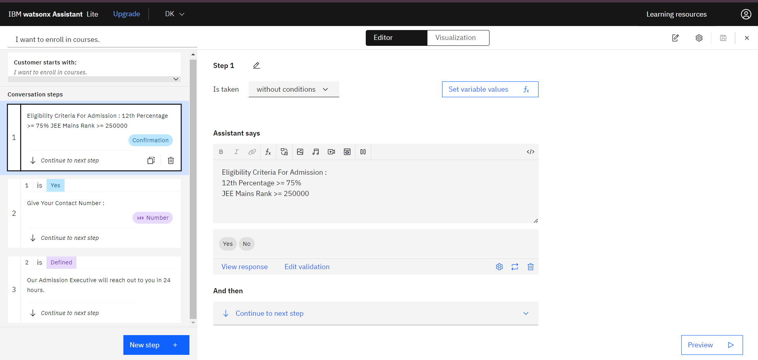
Result

Slide 12
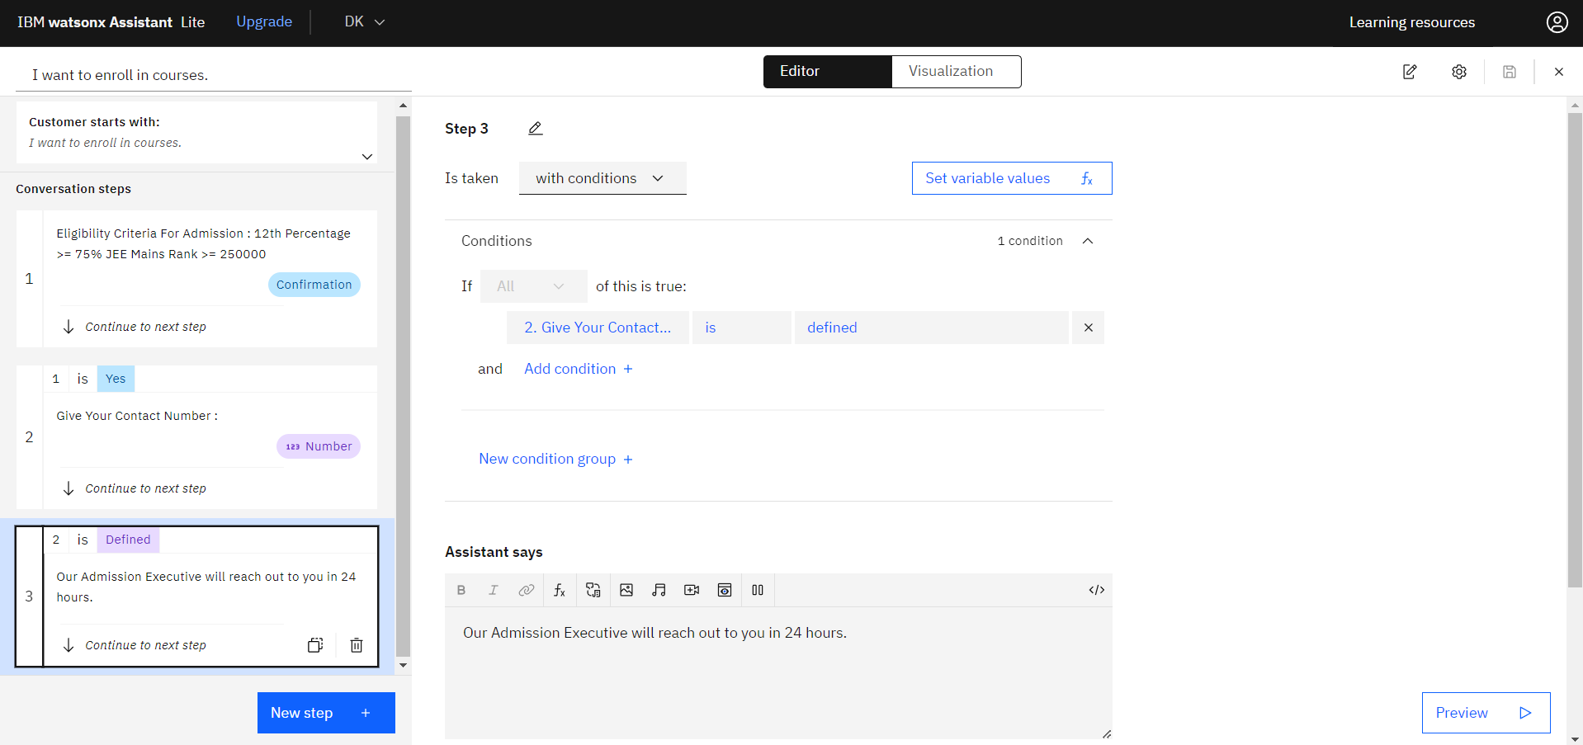
Result

Slide 13
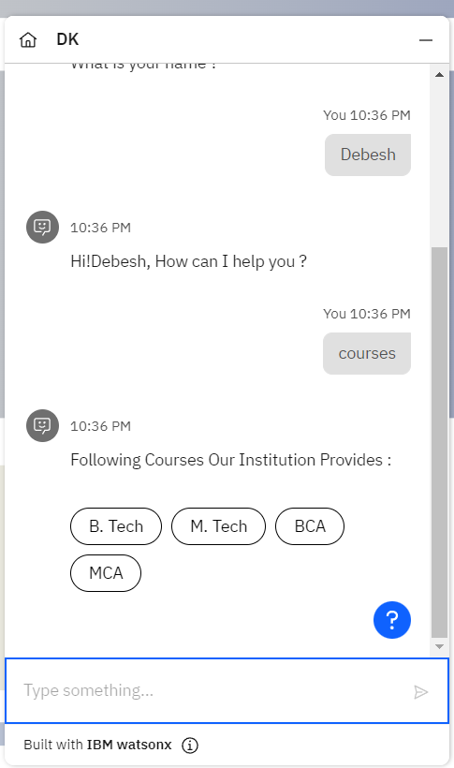
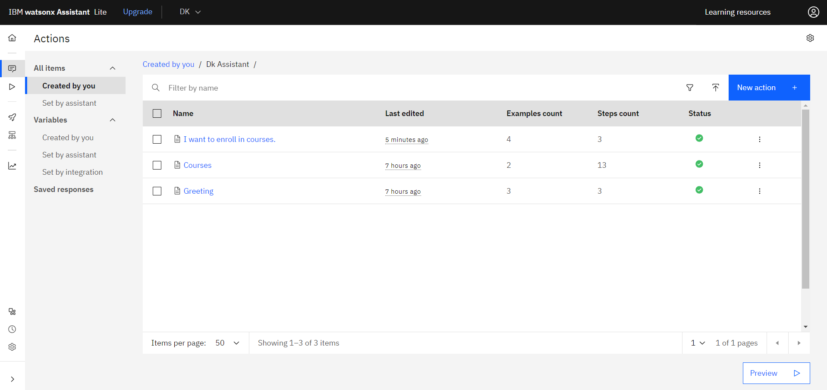
Result

Slide 14
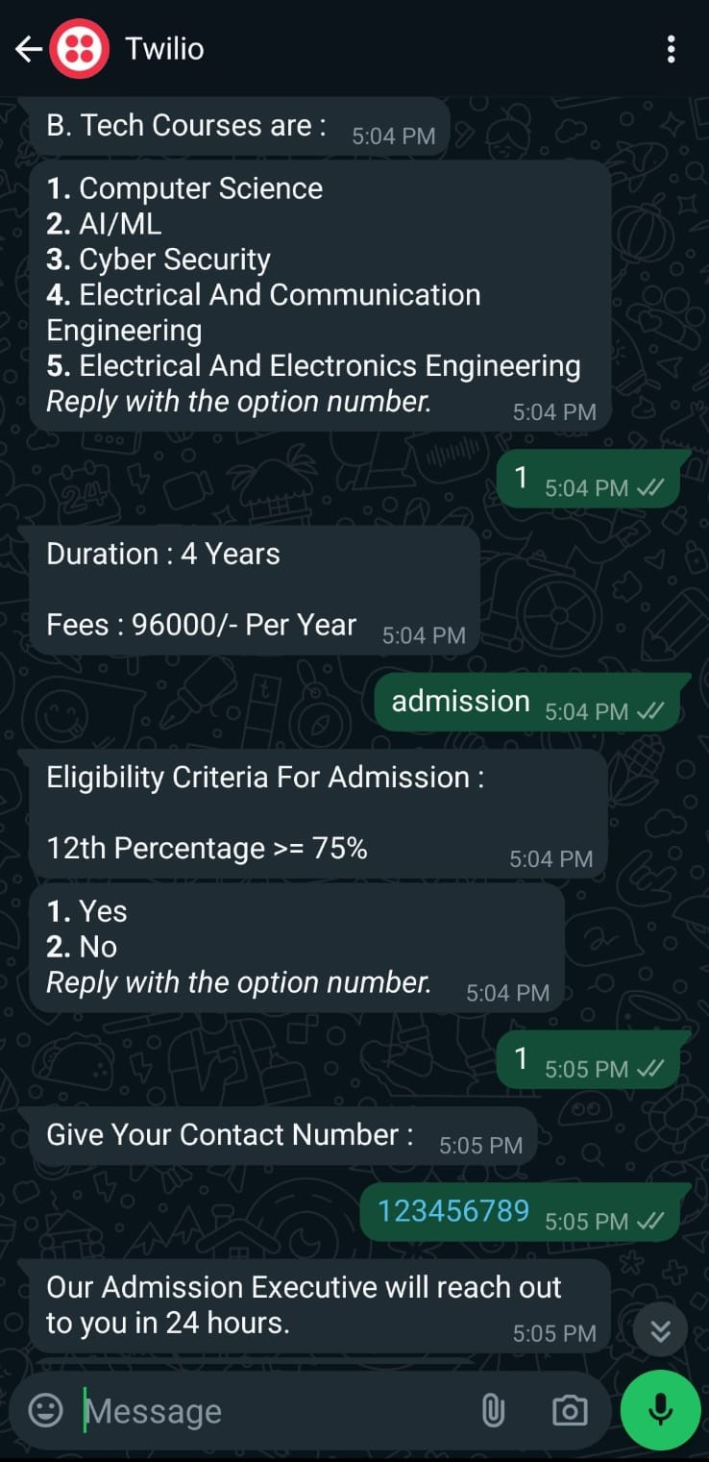
Result

Slide 15
Project Link(GitHub, Google drive link)
https://web-chat.global.assistant.watson.appdomain.cloud/preview.html?backgroundImageURL=https%3A%2F%2Fau-syd.assistant.watson.cloud.ibm.com%2Fpublic%2Fimages%2Fupx-a1a01b08-1184-4202-a51c-c0db1bb0a546%3A%3Ab93fbfb3-638f-4883-9d43-8677c1ffc841&integrationID=86041259-fe21-495c-ab48-ea845d40b761&region=au-syd&serviceInstanceID=a1a01b08-1184-4202-a51c-c0db1bb0a546
GITHUB LINK :
https://github.com/debeshkumar-DK/IBM-WatsonX-AI

Slide 16
Conclusion
In conclusion, the development of a college admission chatbot offers a practical solution to enhance the application experience for prospective students. By leveraging natural language processing and secure data collection, the chatbot effectively guides users through the admission process while providing timely and accurate information. With its user-friendly interface and feedback mechanism, the chatbot ensures continuous improvement and optimization, ultimately contributing to a seamless and efficient admission experience for both students and the college administration.

Slide 17
Future scope
Personalized Assistance: Incorporating machine learning algorithms can enable the chatbot to analyze user preferences and behaviors, offering personalized recommendations and tailored assistance throughout the admission journey.
Multilingual Support: Integrating language translation features can make the chatbot accessible to a wider audience, including international students, thus diversifying the applicant pool and enhancing the college's global reach.
Virtual Tours and Events: Enhancing the chatbot with virtual tour functionalities and event reminders can provide prospective students with immersive experiences, allowing them to explore campus facilities and participate in online admission events.

Slide 18
References
IBM watsonx Assistant tutorial

Slide 19
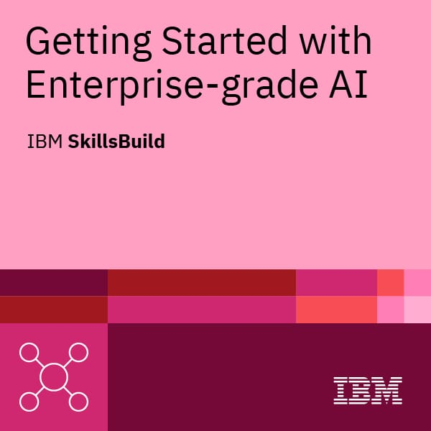
course certificate 1

Slide 20
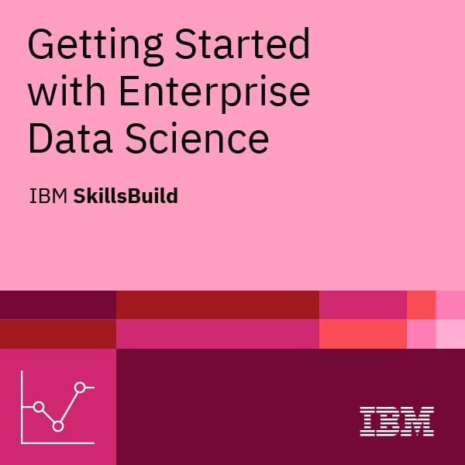
course certificate 2

Slide 21
THANK YOU

